Slide 1

Welcome to

Slide 2
Introductions
Name
Work/School
An interesting fact about yourself

Slide 3
Who we are
We are a Seattle-based software startup focused in genome engineering.
Our goal is to accelerate scientific research by introducing modern UI/UX to existing technologies and to construct novel algorithms that incorporate predictive functionalities.

Slide 4
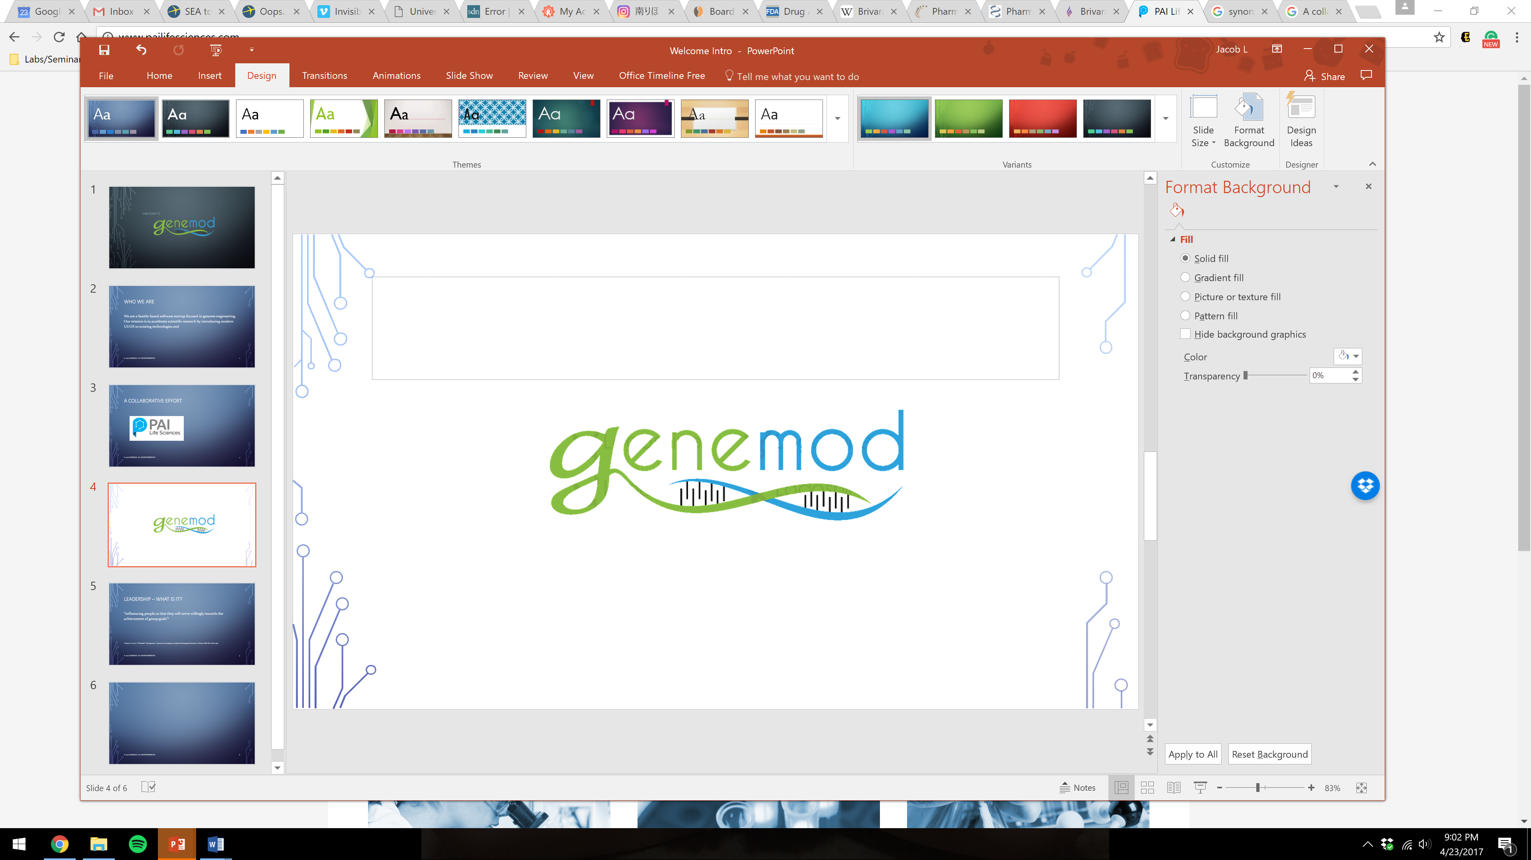
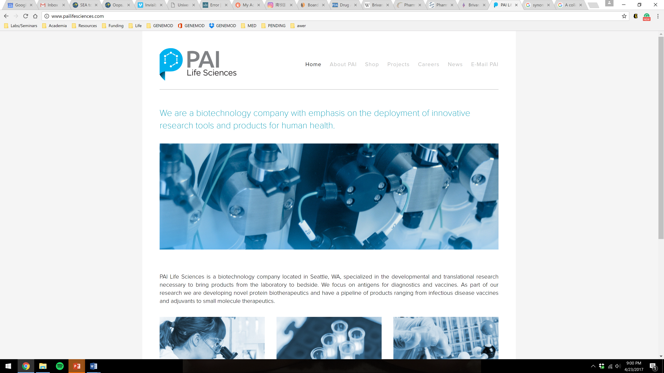
A collaborative effort

Slide 5
Leadership – what is it?
“influencing people so that they will strive willingly towards the achievement of group goals”¹
¹ Koontz, H. and C. O’Donnell. “Management: A System of Contingency Analysis of Managerial Functions”. McGraw-Hill, New York, 1976.

Slide 6
Leadership styles
Benevolent Leader | Team Leader
Laissez-faire Leader | Autocratic Leader
Concern for people
Concern for production

Slide 7
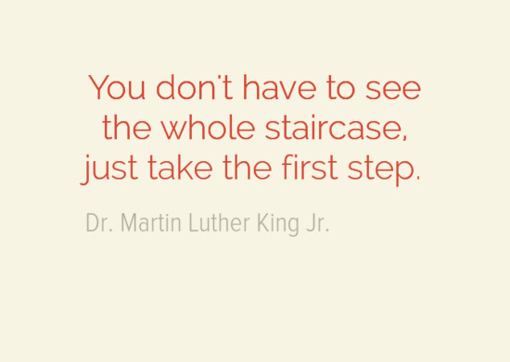
Immediate management goals
To gain insight to a collective vision
To establish a transparent work culture
To navigate early startup hurdles
To overlook pitfalls
To motivate everyone to work as a team
To engage yourself

Slide 8
work ethic
Emphasis on Quality
Team members do their best to produce great work, not merely churn out what is needed. Their commitment to quality improves the startup’s overall quality.
Dependability
Team members can be relied on to keep their promises. They are always on time and prepared for meetings, and deliver work on schedule and on budget.
Humility
Teams acknowledge everyone's contributions and freely share credit for accomplishments. They show gratitude to colleagues who work hard.
Integrity
Integrity fosters trusting relationships among colleagues, creates a supportive environment for honest feedback, and holds everyone to high moral standards to not distribute intellectual property or create problems.

Slide 9
Reality
The Beauty | The Ugly
You directly benefit from the contributions you make It’s an investment in yourself A unique growth opportunity The ability to learn | Startup culture is difficult and relentless It makes you want to quit

Slide 10
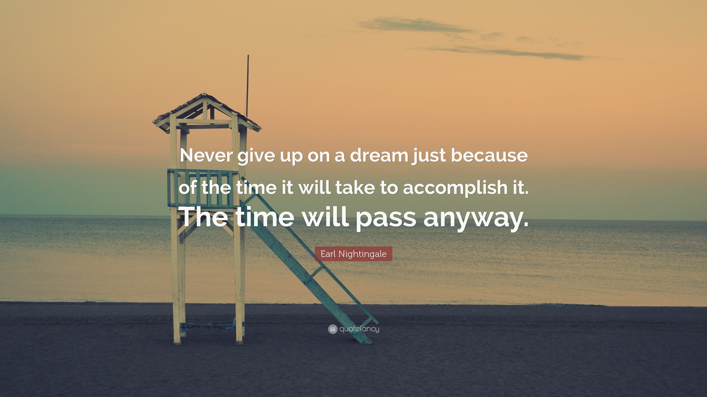

Slide 11
Project Timeline

Slide 12
2017-2018
Project Bluejay | Complete
11/4/2017
Project Fruit | Complete
12/2/2017
Welcome Tina Lu!
Project DNA | Complete
Project RNA | Complete
Launch
4/26/2017
7/1/2017
10/7/2017
1/1/2018
2017
Mar
Apr
May
Jun
Jul
Aug
Sep
Oct
Nov
Dec
2018
2018
Today
120 days
3/4/2017
Project DNA
7/1/2017
99 days
7/1/2017
Project RNA
10/7/2017
92 days
9/2/2017
Project Fruit
12/2/2017
155 days
6/3/2017
Project Bluejay
11/4/2017
* All projects begin or end on the first Saturday of any month
** All intellectual property (IP) owned by GENEMODTM is internally restricted until Launch day

Slide 13
2018-2019
2018
Jan
Feb
Mar
Apr
May
Jun
Jul
Aug
Sep
Oct
Nov
Dec
2019
57 days
1/6/2018
Today
Project Q1-2018 TBD
3/3/2018
92 days
3/3/2018
Project Q2-2018 TBD
6/2/2018
92 days
6/2/2018
Project Q3-2018 TBD
9/1/2018
92 days
9/1/2018
Project Q4-2018 TBD
12/1/2018

Slide 14

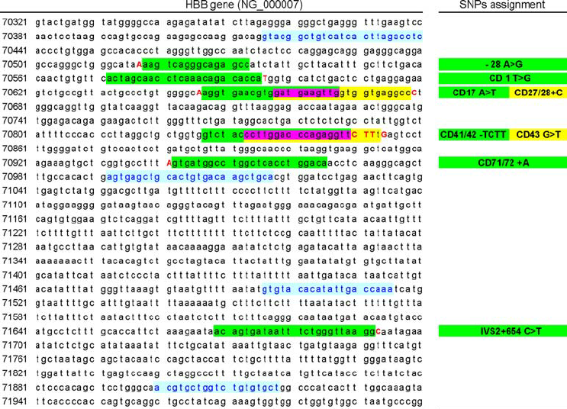
Project DNA
Embedded web workspace
Similar to MS Word
Bulk of functionality, real-time analysis
Novel
Text block watermark integration
Novel
Real-time restriction enzyme selection
Will require enzyme database to pull info from
Novel
Basic real-time values
Melting temperature, GC content, etc
Visual gene construction builder
Applicable to other projects
Modern UI/UX
Novel
We exclude legends for simplicity

Slide 15
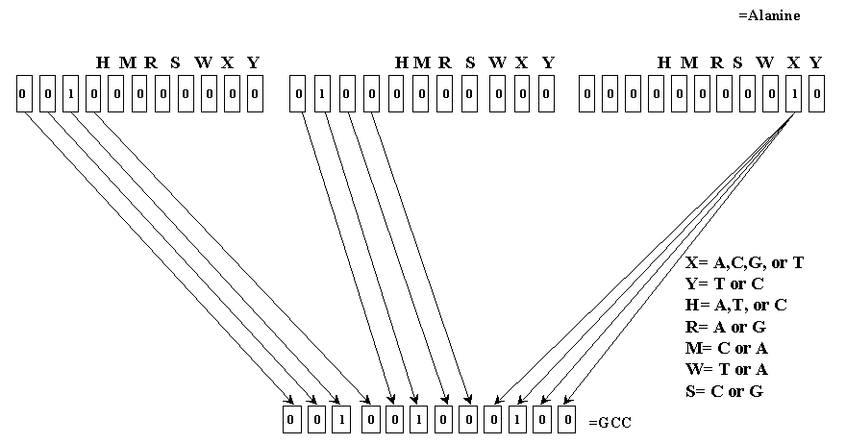
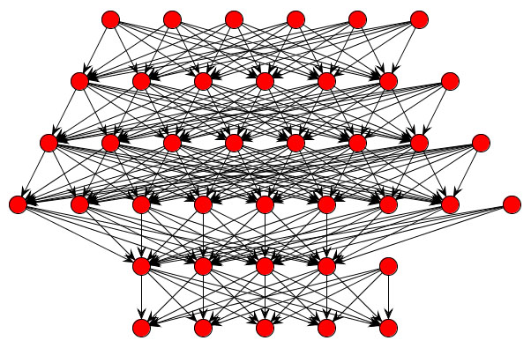
Project Bluejay
Neural network
Program outsourced from PAI Life Sciences
Novel
AI prediction algorithm
Eventually to incorporate into Project DNA
Novel
More outsourced programs to come
PAI Life Sciences started out as an AI company

Slide 16
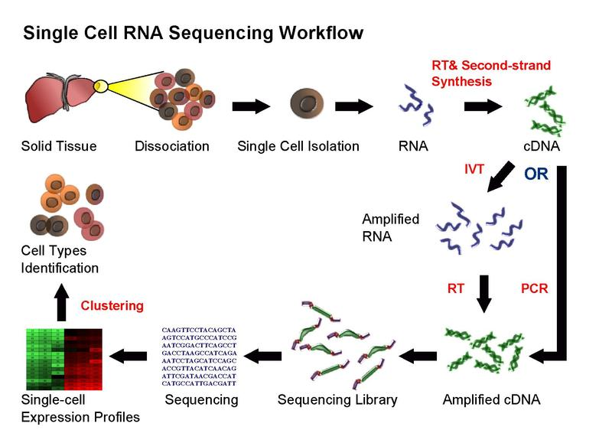
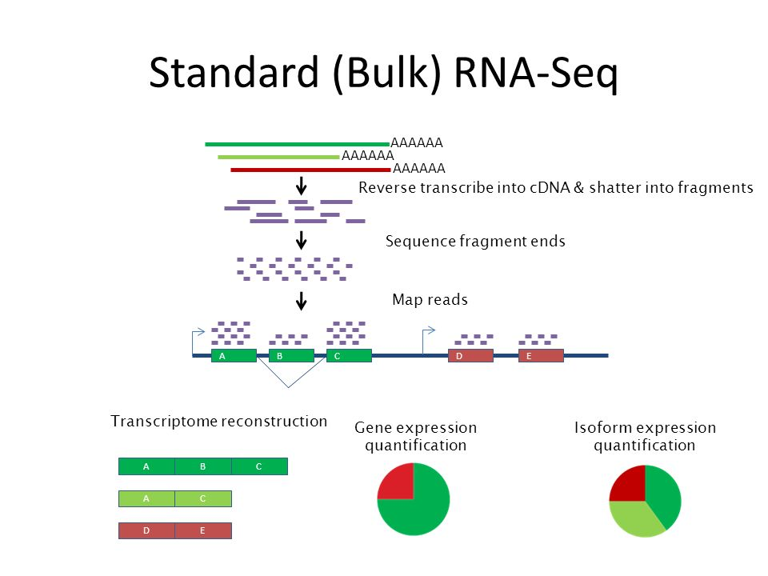
Project RNA
DNA to RNA
Simple conversions
RNA processing
mRNA regulatory elements
i.e. riboswitches, etc
Automated pattern detection and notification system
Novel
Basic real-time values
Melting temperature, GC content, etc

Slide 17
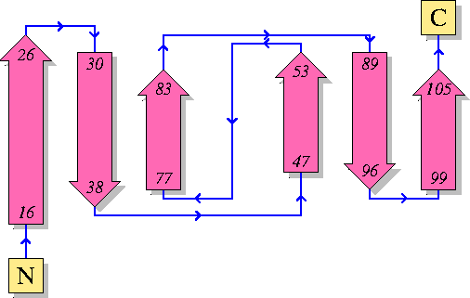
Project Fruit
DNA & RNA to Protein
Simple conversions
Protein processing
Protein regulatory elements
Basic real-time values
Melting temperature, GC content, etc

Slide 18
Conclusion

Slide 19
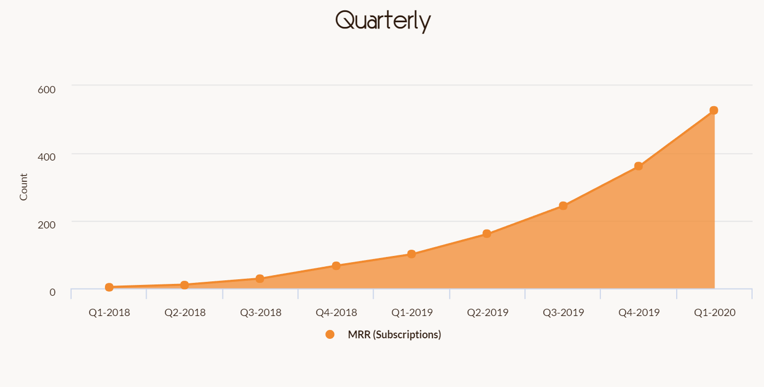
Market traction

Slide 20
Meeting Schedule
 | Sun | Mon | Tues | Wed | Thurs | Fri | Sat | Total
Q1-2017 | 3-6pm/3h | 8-10pm/2h |  | 8-10pm/2h |  | 8-10pm/2h | 3-5pm/2h | 11h
Q2-2017 | 3-5pm/2h |  |  | 8-9pm/1h |  |  |  | 3h
Q3-2017
Q4-2017
Q1-2018
Q2-2018
Q3-2018
Q4-2018

Slide 21
Where are we now?
We are an ambitious startup. With no prior experience in the world of entrepreneurship, we have secured a substantial seed fund in under two months as well as a partnership with a multi-million biotechnology company.

